Slide 1
Sentiment Analysis and Topic Modeling Insights

Slide 2
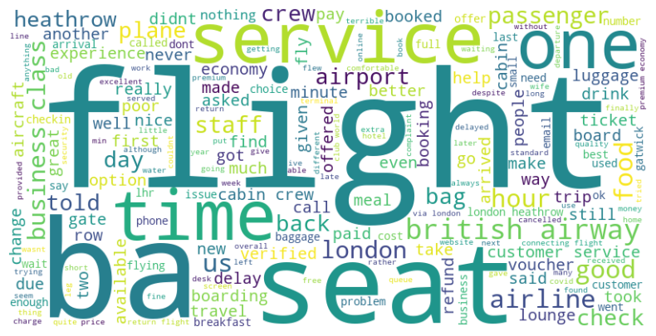
Key Words in Reviews

Slide 3
Sentiment Distribution
Number of Positive Reviews: 644
Number of Negative Reviews: 341
Number of Neutral Reviews: 15

Slide 4
Top Words for Each Topic
•Topic 1: •Topic 2: •Topic 3: •Topic 4:
Flight airline airport heathrow
Boarding hours voucher baggage
BA London staff delayed
Food customer refund plane
Service airways booked seat

Slide 5
Summary
Most reviews are positive, with a majority falling into the 'Positive' sentiment category.
Key words like “Time," "Service," and “Economy" are frequently mentioned in the reviews.
Topics identified include Technology, Customer Service, and Pricing, indicating diverse discussions.

